Slide 1

Notes:
Introduce self. “Wow!! I am excited to be here to share with you something that is going to make this year one of your best ever. I have discovered a program called Student Success Skills and it really works. It sets students like you up for success. Let me explain it to you.
They looked at all sorts of students from all over the country that were successful in all sorts of areas, school work, athletics, having good relationships, knowing how to handle tough situations, and they broke the code. They discovered that the thing that separates the most successful from the rest were a few key skills and strategies.
Now here is why I am excited. These few key skills and strategies are easily taught to anyone who wants to learn them. I became really convinced when I learned that studies have consistently shown that when students just like you have been taught these skills that they learned them easily and where able to use them right away. And the really cool thing is that almost everyone learned them so well that they improved dramatically on goals they selected including math and reading on their state standardized test.

Slide 2
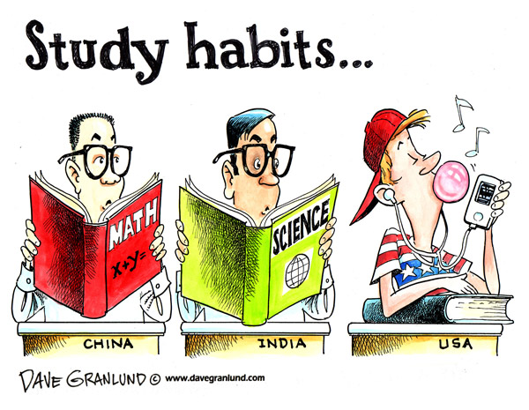
Which one are YOU?
Created by Terese Ewing
Notes:
Studies show that it takes about 28 days to form a new habit.
I’m here to teach you all some strategies to help you form better study habits and test-taking skills!

Slide 3
Questions to think about
How has your attendance been each year?
How do you feel about homework?
How much time do you spend studying each day?
Do you use notebooks? How?
What happens after a teacher gives you notes or tells you to read a chapter?
What book are you reading right now?

Slide 4
Are You An Effective Learner?
I check homework, make sure it’s neat, and put my name on it before turning it in.
I know how to study – NOT look over notes, but really study.
I review a subject even if I don’t have an exam or test this week.
If I am having problems with a subject, I talk them over with my teacher early.
I get my homework done as early as possible without distractions.
I read all the comments and suggestions my teacher might make about my work.
I make flashcards for all the vocabulary used in each subject.
I have a folder on my desktop for each class with all notes, assignments.
I plan my time by writing down everything I have to do and by what time.
I know some tricks for how to memorize facts.
I never wait until the night before a test or quiz to study.
I am involved in other activities besides just attending school.
I attend class regularly and am never tardy to school/class.
When I have to be absent, I request my work immediately by email and check Haiku. Then, I turn in all makeup work.
Notes:
Study Habit Test!
Be Honest! Don’t comment. Just answer on paper or laptop.
We’ll come back to this later.

Slide 5
You can make your “learning net” smaller by adding key skills and strategies.
Notes:
Here’s how I think they did it. Picture a fishing boat. You are using a big net with big gaps to catch your fish. When you pull in the catch you miss a lot of fish. Now picture another net with much smaller gaps. When you pull in this net you get many more fish. The way to make the gaps in our learning net smaller is to add these key skills and strategies I want to share with you.
When you use these new strategies and skills you are able to net more information easier and to be successful at learning whatever you want to learn. When students use these skills to do better in school, they find that they do can learn any subject easier and better than before. It is really cool.

Slide 6
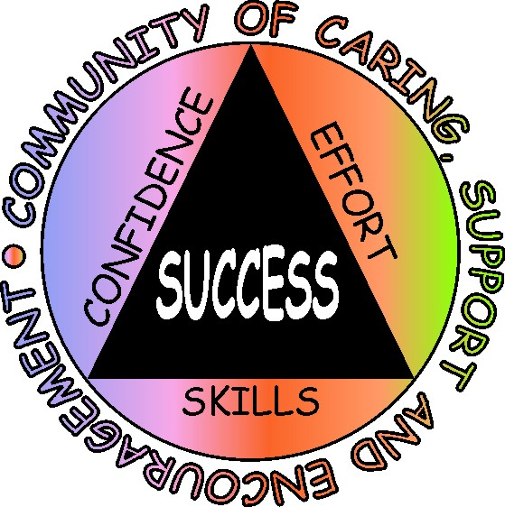
Student Success Skills: We Focus on Five Things
Creating a caring, supportive and encouraging classroom
Goal setting, progress monitoring and success sharing
Cognitive/Memory skills
Performing under pressure:
Managing anxiety
Building Healthy Optimism
Notes:
The Student Success Skills program can be summed up with five things that we focus on”: Show “We Focus on Five Things” slide and ask volunteers to read each item. After each provide a brief statement such as:
Goal setting is a skill that all successful people have. We will practice goal setting each week and rate our progress. The really cool part about this one is that we will hear from students in this class who are making improvements and everyone will hear lots of success strategies.
Having a caring, supportive and encourage classroom makes everyone want to come to class and to do well. We will learn some easy ways to make this a classroom like that.
You are going to love some of the easy to use memory strategies.
All of us have had the experience of being a little to anxious and not performing up to our ability. We will learn a few ways to stay in control even under pressure and perform to our ability.
Healthy optimism is a key idea that runs through this entire program. We will learn how to trust in our ability and change our strategy if what we are doing is not working.

Slide 7
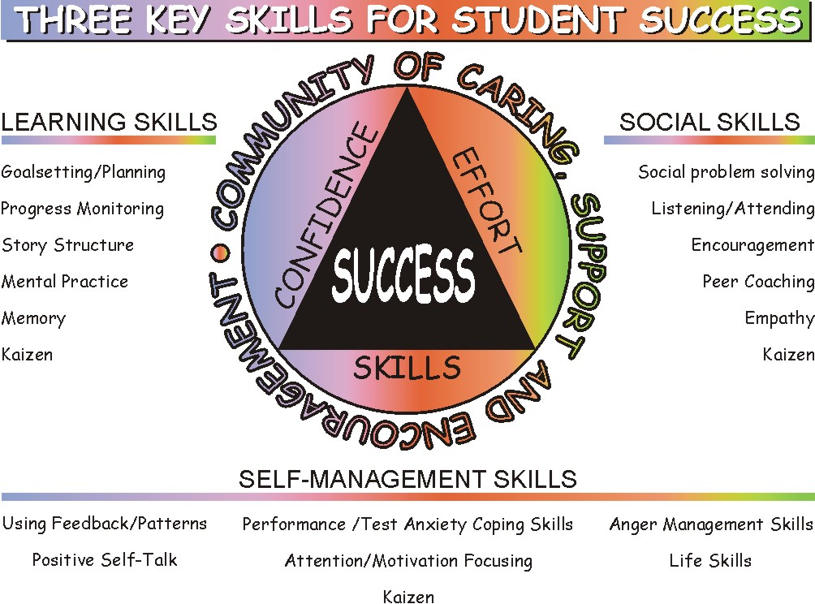
Notes:
We will be finding out more about these Learning Skills, Social Skills and Self-management Skills. We know that a combination of these three skill sets in combination with a caring community seems to be the keys to academic and social success.

Slide 8
So, What is in it for Me?
Makes learning easier
Standardized tests easier
Look forward to coming to class
Learn memory strategies to help remember facts
Learn to manage anxiety so you can perform better under pressure
Have better relationships with peers
Be happier and healthier
Notes:
So, here is what’s in it for you. They asked students just like you who had tried this program what they got out of it and these are some of the most frequent answers: As we go over each of them pick out which 1-2 of these would be most important to you.
Ask volunteers to read each one and provide a little background such as:
Having these skills makes learning easier and sets you up for success.
Because learning is easier,when it comes time for testing in the spring it is easier because you have learned so much more.
You will learn how to help create the kind of caring, and encouraging atmosphere that makes you look forward to coming to this class.
You will learn some easy to use memory strategies that make remembering key facts easier.
You will learn how to manage anxiety so that you can perform at your best even under pressure.
These skills will help you to have the kind of caring relationships you want with peers and others.
These skills will help you to manage yourself so that you have more happiness, and greater health.
Now that we have gone thru what other students got from the SSS program choose the top two things you most want from the program. Give me a thumbs up when you have your top two picked out. Next go through each and ask “Who had this one as one of your top two.” Repeat for each the seven.
Are you ready to get started learning the SSS strategies? Then lets get started with Building a community of caring, support and encouragement. Go to next slide.

Slide 9
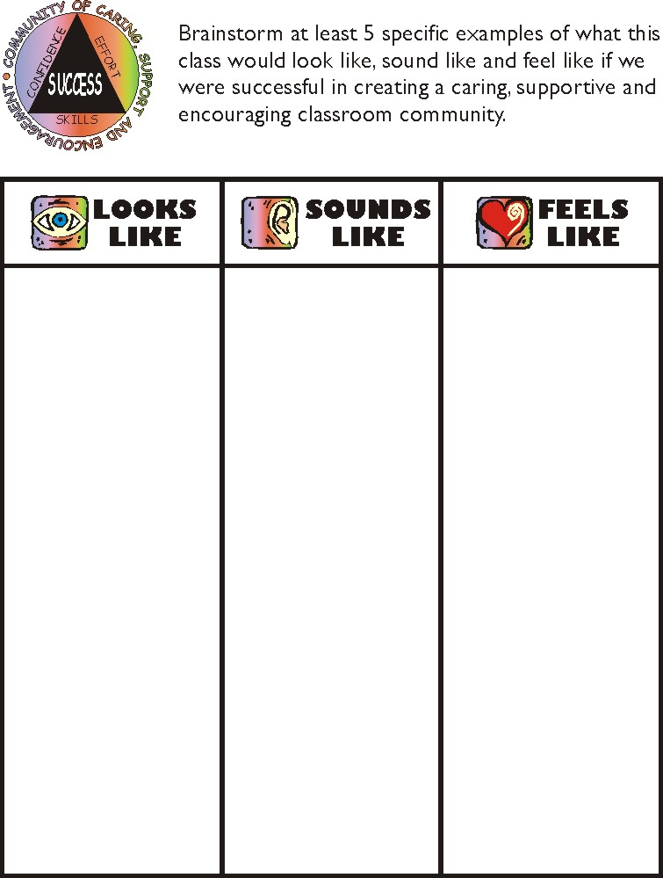
Notes:
Let’s see if we can figure out what a caring, encouraging, supportive classroom would look like, sound like, and feel like.
Divide class into groups of three: Provide a copy of this sheet or flip chart paper and markers to each trio.
Have a flip chart paper divided into three columns: Looks Like Sounds Like Feels Like for recording their answers.
Ask each trio to brainstorm 5 concrete examples of what this class would look like (60 seconds). Ask trios to report to whole class. Record answers onto composite chart.
Next, ask each trio to brainstorm 5 concrete examples of what this class sound like (60 seconds). Ask trios to report to whole class. Record answers.
Then, ask each trio to brainstorm 5 concrete examples of how it would feel to be in this kind of caring supportive and encouraging class (60 seconds). Ask trios to report to whole class. Record answers. Save flip chart sheets for posting in the class.
This is a powerful norm setting activity as students hear other students describe the kind of classroom they want in very concrete terms. If you hear less than concrete descriptions probe for more concrete examples.

Slide 10
One of the greatest predictors of student success is their level of healthy optimistic thinking.
Seligman (1995).
Notes:
Being optimistic about what you can accomplish is important. Read quote.

Slide 11
Key to Healthy Optimism
Don’t doubt your ability
Doubt your strategy
If what you are doing is not working
Try Something Different!!!
Notes:
Being optimistic about what you can accomplish is important.
If what you are doing isn’t working don’t doubt your ability. Instead you can take a look at what you are doing and try something else.
Ask students “ Have you ever know someone who tried the same losing strategy over and over. Sometimes people do this because they do not know other strategies. We are going to make sure everyone in here knows lots of strategies that lead to success.
Don’t continue the same strategy if it haven’t worked. If you do not know another one ask someone who is likely to know. We need to help each other in this class to be successful. When we help each other we all win.
1. Don’t doubt your ability.
You can doubt your strategy.
3. If what you are doing isn’t working? try something different

Slide 12
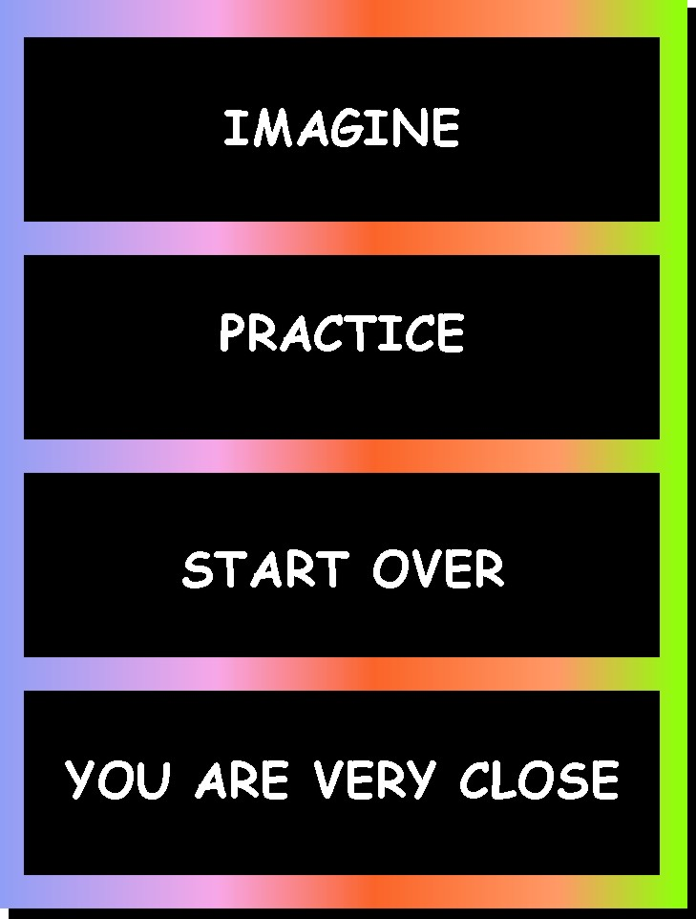
Notes:
Go over this poster and ask students to pay attention since next week you will ask them to explain it to each other.
Imagine: It is important to be able to picture yourself being successful. Remember-Don’t doubt your ability. See yourself being successful in using the strategy you have chosen to help you reach your goal.
The next step is to practice. Put into practice the skill or strategy you chose to help you reach your goal. Notice even small improvements.
If your strategy is not working, don’t doubt your ability, you can start over with a different strategy or maybe just make a slight change to the strategy you are currently using.
You are Very Close reminds you to never give up. Tell yourself that you are very close and with continued practice you will get there.

Slide 13
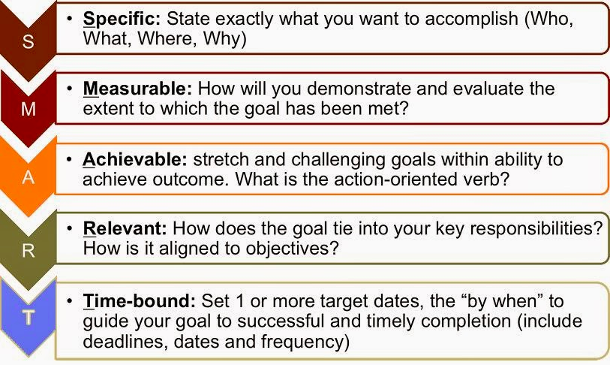
S.M.A.R.T. GOALS
Notes:
Examples of SMART Goals:

Slide 14
SMART Goals
This year, I will get good grades.
Is this a SMART Goal?
SMART Goal: During the first 9-weeks, I will complete my homework between 5:00p-7:00p on school nights at my desk in my bedroom. After completing my homework, I will put my homework in a homework folder and put it in my backpack. At school the next day, I will turn in my homework to my teacher. I will revise this goal after receiving my first 9-weeks report card.
Notes:
Specific: The goal addresses what you want to accomplish and answers the 5 Ws
Measurable: Because the goal specifies when and how often the behavior will occur, it is easy to measure whether you did it
Attainable: This goal is realistic because it specifies “school nights” and not every night of the week. It is also attainable because it is only 2 hours a night. It’s not asking that you change your lifestyle or get straight A’s
Relevant: For a student whose incomplete homework was resulting in lower grades, this goal is relevant because it leads to completed homework
Time-bound: The goal names specific times when the student will study and how often. It also specifies the marking period so that the goal can be revisited and readjusted depending on the results of the student’s report card

Slide 15
SMART Goals
Goal: Get Organized
How can you make this a SMART Goal?
SMART Goal: After school, on the first day of school, I will organize my backpack by creating a folder or binder for each of my classes with places to keep my assignments, notes, and homework. After my backpack is organized, I will spend 10 minutes each day when I get home (during the school year when school is in session) to go through the items in my backpack to make sure they are in the proper location. I will then dispose of any items I do not need or do not belong in my backpack.
Notes:
Once you achieve one goal, move on to the next one!

Slide 16
Kaizen
Little by little,
Bit by bit,
I’m improving,
Everyday
Notes:
Introduce the concept of Kaizen from slide.
One way to stay optimistic is to use the principle of Kaizen. As we try new skills and learn to check our progress we want to become experts in noticing even very small positive changes in ourselves and others. When we notice a positive change in others we want to be sure and tell them that we noticed it. Saying encouraging things to ourselves and others helps us all stay focused and also helps us to make and keep friends.
Kaizen is also about continuous improvement. We never reach perfection. We can always improve. Making improvement brings us joy.
Have students stand up and follow you through the hand play for Kaizen. Provide some background such as: All cultures have found ways to remind members of important ideas. Hand plays and other physical movements have been a way to communicate key ideas. While this is a Japanese word, the hand play I will show you comes from the aborigines of Australia.
Counselor/teacher leader--See hand-play description in manual, section 7 page 240

Slide 17

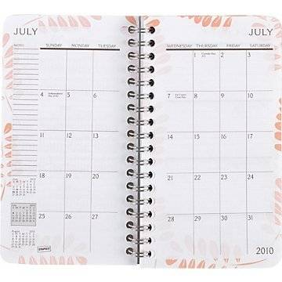

Getting Organized
Folders for each subject on desktop
Put EVERYTHING in notebook as soon as you get it
Write assignments in planner BEFORE bell rings
Lay out clothes, school stuff night before
Set time and TIDY place aside for homework/studying
See counselor or teacher if need supplies
Don’t wait until night before to study or do project
Notes:
Here are some strategies for making this school year a success and to help you achieve your goals!

Slide 18

Studying
Do homework when assigned
Review notes DAILY
  Read
  Recopy
  Make flashcards
    www.studyblue.com
    www.quizlet.com
Summarize reading in your own words
Mnemonic devices (next slide)
Repeat out loud
Have someone quiz you
Make your own test

Slide 19

Mnemonic Devices
Ways to help you remember
Words or sentences
  Great Lakes: HOMES
  Colors of spectrum: ROY G. BIV
  Order of operations: Please Excuse My Dear Aunt Sally
  Planets: My Very Educated Mother Just Served Us Nine Pizzas.
Rhymes
  Columbus sailed the ocean blue in ____

Slide 20
Body Location Memory Pegs
Ten top foods for health:
  Blueberries
  Nuts
  Salmon
  Broccoli
  Bananas
  Frozen Yogurt
  Olive Oil
  Brown Bread
  Spinach
  Tomatoes
Notes:
Go through the Body Location Memory Pegs to learn the ten top foods for health.
Stress that students can use this for any content they want to remember for any course.
Go to next slide to continue with the third of the seven keys.

Slide 21


Taking Notes
If teacher writes it on board, repeats it, or says it’s important, WRITE IT DOWN!
PUT IN NOTEBOOK (or folder on desktop)
Listen carefully!
Write examples and page numbers
Abbreviate words or use symbols
  With = w/
  → = led to, results in
  Cont’d = continued
  b/c = because

Slide 22
Boosting Memory - Summarizing
Every 20-30 minutes stop and have students summarize
  Think, write, pair share, volunteer share
  Small group discuss “Most Important Ideas”
At the end of the lesson or unit:
  Work in pairs or small groups to create graphic organizer of “Most Important Ideas”
Notes:
Let’s take a look at some strategies that will help improve our memory and our performance on tests and quizzes.

Slide 23
Boosting Memory – Graphic Organizers
Most important ideas
Visual summary
Shows how important ideas relate
Top Ten Foods
Dairy
Grains
Protein
Fruits & Veggies
Brown Bread
Salmon
Spinach
Tomatoes
Broccoli
Notes:
Review how this might be the beginning of an organizer to remember the Top Healthy Foods and ask students how they might proceed from here.

Slide 24
Boosting Memory: Index Cards
Create index cards using the “Most Important Ideas” (from outlines, concept maps)
Ask teachers to provide a few examples of effective index cards related to the upcoming test.
Review note cards six times before the test.
Review cards one last time just before the test.
Notes:
Next: Create index cards using your “Most Important Ideas”
After you are clear on what the “Most Important Ideas” are and have organized them into an outline or concept map, it is helpful to break the ideas into small chunks that are easier to remember.
Review your cards six times before the test, including one last time just before the test.
Work with the teacher to provide a few examples of effective index cards related to the upcoming test.

Slide 25
“Remote Control” Technique
Tie studying to something you like – hit “mute” & review note cards during commercial breaks
Notes:
Discuss the Remote Control technique:
Use the commercial breaks during your favorite TV shows to go through your index cards. Or you can connect your review to some other activity you enjoy, such as listening to your favorite music. This ties studying to something you like and makes it seem less of a hassle.
Go through the math of reviewing cards six times. It takes only approximately 30 minutes. It works best if the reviews are spaced apart.

Slide 26
Boosting Memory – Other Strategies
Mnemonic Devices
Body Location Memory Pegs
Creating a picture that reminds you of the facts or word
What others do you know?
Notes:
Let’s look at a few other strategies.
NOTE: It is very helpful to talk with the teacher and enlist their support in reinforcing these memory strategies. Having some examples from the teacher of graphic organizers and getting the teacher to provide time in class to have students work together to create their own graphic organizers and compare “Most important ideas” and then make note cards from the graphic organizer before the next test is the best way to show students how powerful these techniques are. Inspiration Software is one of the leaders in visual learning. You can download free examples at www.inspiration.com. Many recent texts have graphic organizers for each chapter.

Slide 27

Calm Place
Use your imagination to create a calm place.
Notes:
The first step in becoming skilled at performing under pressure is using your imagination to create a calm place.
Guide students through Calm place activity. Read script.
After the activity ask students to write or draw something about their Calm place that will help them to remember what it is like (60 seconds).
When students have completed their drawing say – “In just a moment I will ask you to share whatever you choose about your Calm place with a partner. Remember to practice Listening with Eyes, Ears and Heart.

Slide 28

Breathe, Picture, Focus
Breathe in slowly to count of 5, hold for count of 5, exhale to count of 5
Picture yourself in your “Calm place”
Focus on your strategy for the task at hand
Notes:
Here is one way you can use your Calm place. Introduce breathe, picture, focus sequence.
Breathe - take slow deep breaths. Sometimes it helps to count. Count to five on the inhale. Hold for a count of five. Exhale to the count of five. Have students practice.
Picture yourself in your Calm place, It only takes a split second to visit your Calm place to get you out of a negative self-talk loop that often goes along with rising anxiety.
Tell your self to focus on the strategies that you have pre-determined to use for this task. For example, if the task is taking a test, then you have several strategies to focus on. See next two slide for test taking strategies.

Slide 29
Keep Kool Tune Shields
Notes:
Introduce Keep Kool Tune Shields. We can use music to create shields to help us cope with pressure situations. Play a few seconds of an upbeat positive song such as James Brown “I feel good” and then say
Under pressure we sometimes start negative tapes playing in our mind. For example, “this test is way too hard, how do they expect anybody to pass this thing, or If I can’t pass this test I can’t pass anything or I’m never going to get it, everybody will think I’m a loser, I won’t have friends…..
Keep Kool Tunes is a simple technique that lots of people your age use to cut this negative message tape off. It involves three easy steps. Next slide.

Slide 30
“Keep Kool” Tune Shields
Your own positive music mental shields against negative self-talk
3 easy steps
Pay attention and label what is happening: “Ah Ha-there’s my negative self-talk again”.
Start your “Keep Kool” tune playing in your head. This will shift you away from your negative message which robs you of confidence and give you back control of your thinking.
Now that you are back in control decide the best thing to do next.
Notes:
First, notice when the negative message tape is starting up.
Next, use the awareness of the negative message to trigger your positive message. “Time to hit my Keep Kool Tune”. This reminds you to start singing (silently if people are around you) the positive phrase from the song you have already picked out. For example, you start singing, “I feel good, like I know that I would…..” This is switching attention from an automatic negative message to a positive one.
Last, decide what is the best thing for you to do next to handle the current situation instead of letting the negative tape rob you of your confidence.
Ask students to work in pairs and think of a few positive messages in songs that they like and write down the phrase, song title, and artist. Tell students: Be sure the lyric phrase has a healthy message and has the power to shift your mood into a positive frame. One way to judge the power of a tune is to ask yourself, “Do I start smiling when I sing this tune?” (30 seconds)
Ask volunteers to share their positive Keep Kool Tunes with the class. Ask the class if they agree that the song’s message is positive and healthy.

Slide 31

Taking Tests
Don’t wait until night before to study
Sleep well and eat beforehand
Read questions carefully.
Answer questions you know first, * or circle others, go back
Write neatly
CHECK OVER TEST before turning in!

Slide 32
Seven Test Taking Strategies
Use slow breathing to relax.
If you begin to get too anxious, repeat slow breathing and picture your “Calm place” for a moment to break the stress cycle. Focus on your test taking strategy.
Look over the entire test to determine how long it is and where the most points are. Determine a time limit for each section.
If you use acronyms, or other memory aids write them down on a scratch piece of paper.
        (cont.)
Notes:
These are some of the test taking strategies you might choose from. Review the seven test taking strategies. The first two are what we have been practicing. Ask for student volunteers to read strategies 3-7 one at a time and ask after each one is read “How many of you use this one?” (two slides).

Slide 33
Seven Test Taking Strategies (cont.)
5. Answer the easy questions first. Often these questions will have clues to harder questions.
6. Go back to the harder questions. Look for clues. Eliminate any obvious wrong answers. If you are still not sure of the correct answer take your best educated guess.
7. Budget your time so that you have a few minutes left at the end to check your answers. Make sure you do not leave any blank.
Notes:
Continue review of test taking strategies. Ask teacher to guide students through Breathe, Picture, Focus and remind students of these test taking tips just before the next test.

Slide 34
Optimism
Don’t doubt your ability
Doubt your strategy
If what you are doing is not working
Try Something Different!!!
Notes:
Have students join you in the Optimism Cheer: Prompt students with these three lines and ask for a choral response: Students repeat the key word or phrase that is underlined below.
1. Don’t doubt your ability.
You can doubt your strategy.
3. If what you are doing isn’t working? try something different

Slide 35
Attendance
If you’re not in class, you don’t get to hear what’s important and you miss work.
Remember that what you did in a year in middle school, you’re doing in half a year in high school.
More than 8 absences (no matter what kind) = Failure

Slide 36
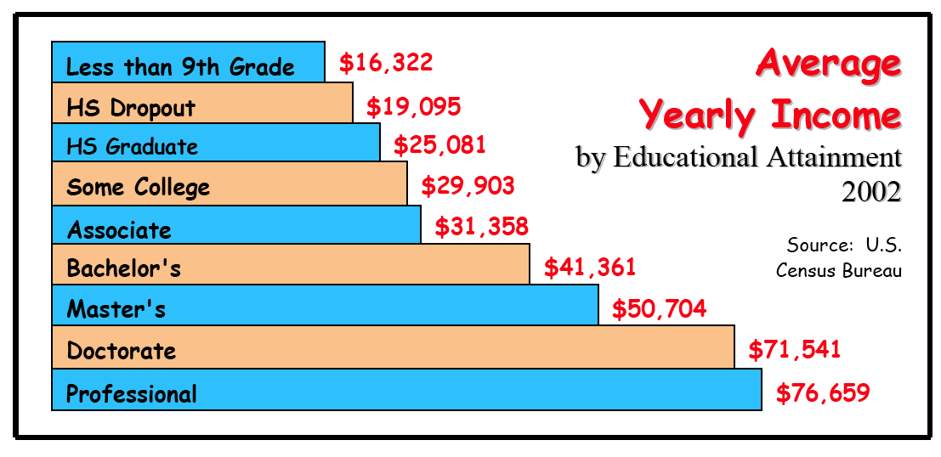
Why does it even matter?
What is GPA?
Why college?

